Slide 1
PROJECT
BEYOND VISION
BLIND ASSISTANCE TOOL
CS3237 - INTRO TO IOT
RAMANA, WAMIKA, WIRA, ZEON

Slide 2
TABLE OF CONTENTS
01
02
03
Motivations
Overall Architecture
Demo
04
05
HW & SW Specs
Other Considerations

Slide 3
MOTIVATION

Slide 4
MOTIVATION
ACCESSIBILITY
SAFETY
COSTLY
Navigating curbs, stairs, ledges could be a challenge
Smoke detectors are not mandatory in households prior to 2018 [2]
Training both guide dogs and users can cost up to $50000 [1]
[1] Guide Dogs Singapore, “Guide Dog Programme,” [Online]. Available: https://guidedogs.org.sg/guide-dogs/guide-dog-programme/
[2] N. J. Sen, “Smoke detectors mandatory in all new homes from June 2018; existing home owners also urged to comply,” The Straits Times, 16 November 2017.

Slide 5
SYSTEM ARCHITECTURE

Slide 6
SYSTEM ARCHITECTURE

Slide 7
DEMO

Slide 8
DEMO
01
02
03
Smart Walking Cane
Waist Belt
Long Term Analytics
Panic Button → Fast Beep → Telegram Message Flame Sensor →Slow Beep →Telegram Message Proximity sensor → Normal Beep
Idle, Walking, Sitting / Getting Up
Fall → Telegram Message
Front-End Showcase

Slide 9
TECHNICAL DETAILS

Slide 10
HARDWARE: WALKING CANE
Flame Sensor [1]
Buzzer [3]
Ultrasonic Sensor [2]
Life-Time
Operating Current: 15 mA
Voltage: 5V
Power: 0.075W
Operating Current: 30 mA
Voltage: 5V
Power: 0.150W
Operating Current: 15 mA
Voltage: 5V
Power: 0.075W
10000 mAh / 60mA = 166 h = 1 Week
[1] https://www.sunrom.com/p/fire-flame-sensor-module
[2] https://cdn.sparkfun.com/datasheets/Sensors/Proximity/HCSR04.pdf
[3] https://www.farnell.com/datasheets/2171929.pdf

Slide 11
HARDWARE: WAIST BELT
MPU-6500 [1]
Operating Current (gyroscope): 3.2 mA
Operating Current (accelerometer): 0.45 mA
Voltage: 3.4V
Power: 0.01241W
Life-time: 1150 mAh [2] / 3.65 mA = 315h = 2 weeks*
* Theoretical life-time before recharge - however, on low power delivery the IMU data becomes inaccurate
[1] https://invensense.tdk.com/download-pdf/mpu-6500-datasheet/
[2] https://www.redcheetah.com/reidsvilleoffice/outpost/item_details/EVEE91BP4

Slide 12
ML MODEL: THE PROCESS
Data Collection
Running and Comparing ML Models
Involving splitting the data into train and test (by user), normalising, encoding labels and preparing sliding windows (3 s)
Data Cleaning and Processing
Each activity performed repeatedly by all members
All data collected combined and visualised
Preparing data for the models
Live testing to choose the best performing model
IMU data stored in separate csv files
Models compared include 1D-CNN, LSTM, LSNET
SisFall dataset cleaned, combined and visualised
SisFall [1] Dataset retrieved from online source.
Transfer learning with CNN model trained using SisFall data.
[1] https://www.ncbi.nlm.nih.gov/pmc/articles/PMC5298771/

Slide 13
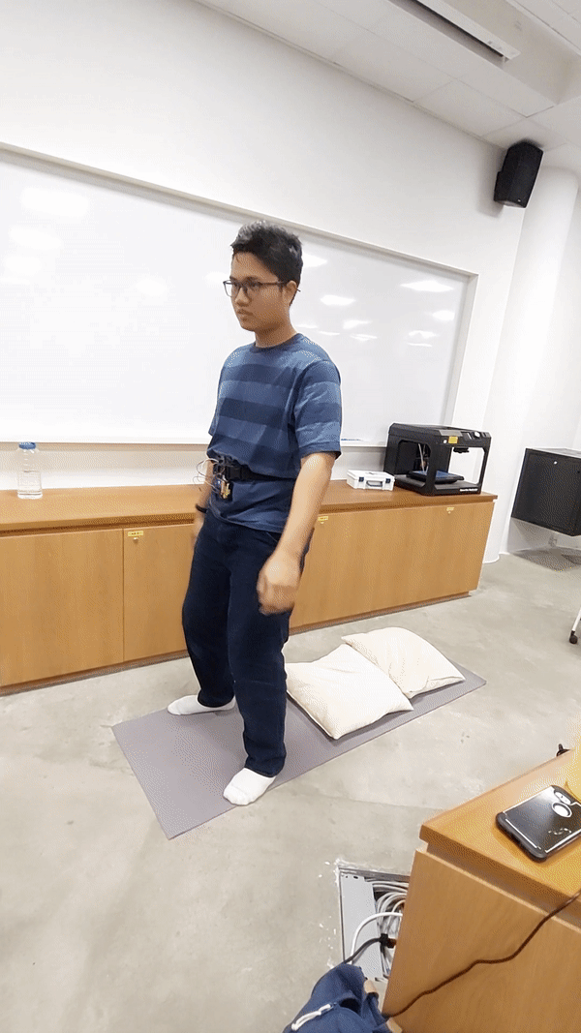
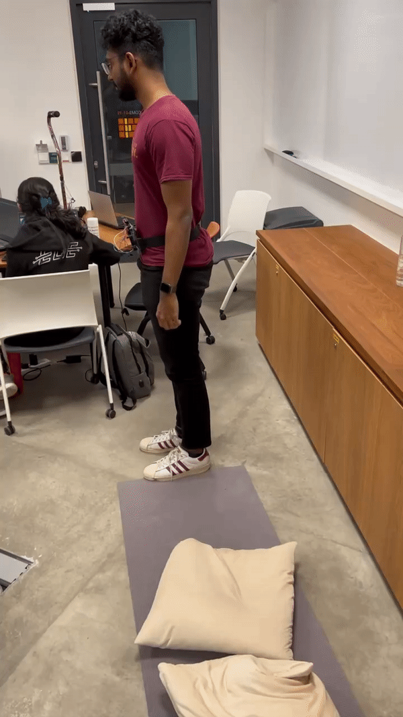
ML MODEL: DATA COLLECTION
Fall data was collected by simulating (forward, backward, and lateral) falls in a safe environment
Collecting data for sitting / standing was relatively easier than collecting data for falls.

Slide 14
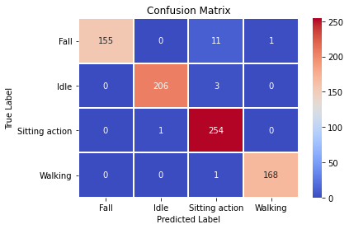
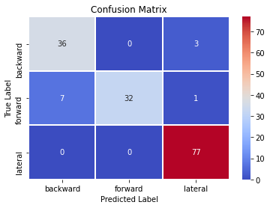
ML MODEL: TRAINING RESULTS
The system is supported by ML models for the following:
Active activity monitoring for fall detection
Detecting fall types for use in long term analytics
Best Model CNN for activity detection
Best Model CNN for fall types
Confusion matrices testing with data collected from one of the team members (not used in training) of the best chosen models

Slide 15
ML MODEL: MODEL TESTING
The activity detection system worked well with both CNN and Transfer learning. However, CNN showed better results while live testing and was also faster in terms of response time and hence was our final chosen model
The best performing model for fall types detection was CNN.

Slide 16
Communications - MQTT
Belt
User’s Phone
Cane
IMU Data stream (20Hz)
GPS trigger
With User’s ID
Laptop
MQTT Client
Panic button trigger
Flame sensor
Real-time GPS coordinates

Slide 17
Communications - MQTT- Scalability
User C
User A
User D
Laptop
MQTT Client
User B
User E
User F

Slide 18
Communications - RESTful API
GET request
Aggregated data
Cloud Server
Long term analytics visualization
POST request
Fall data
Laptop Relay
GET request
Warning message
Telegram API
Telegram
message
User’s NOK
Phone

Slide 19
ANDROID GPS & GOOGLE MAPS INTEGRATION

Slide 20
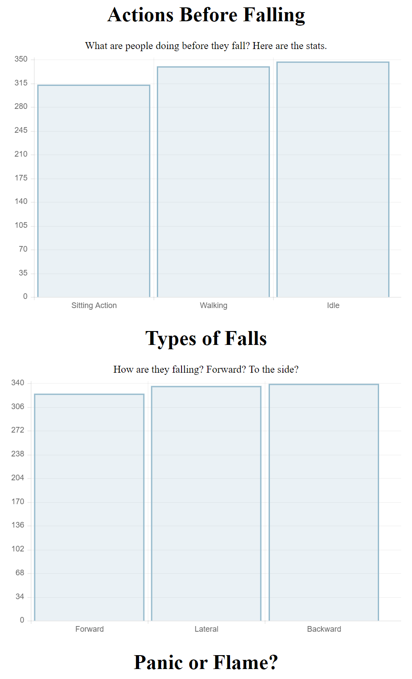
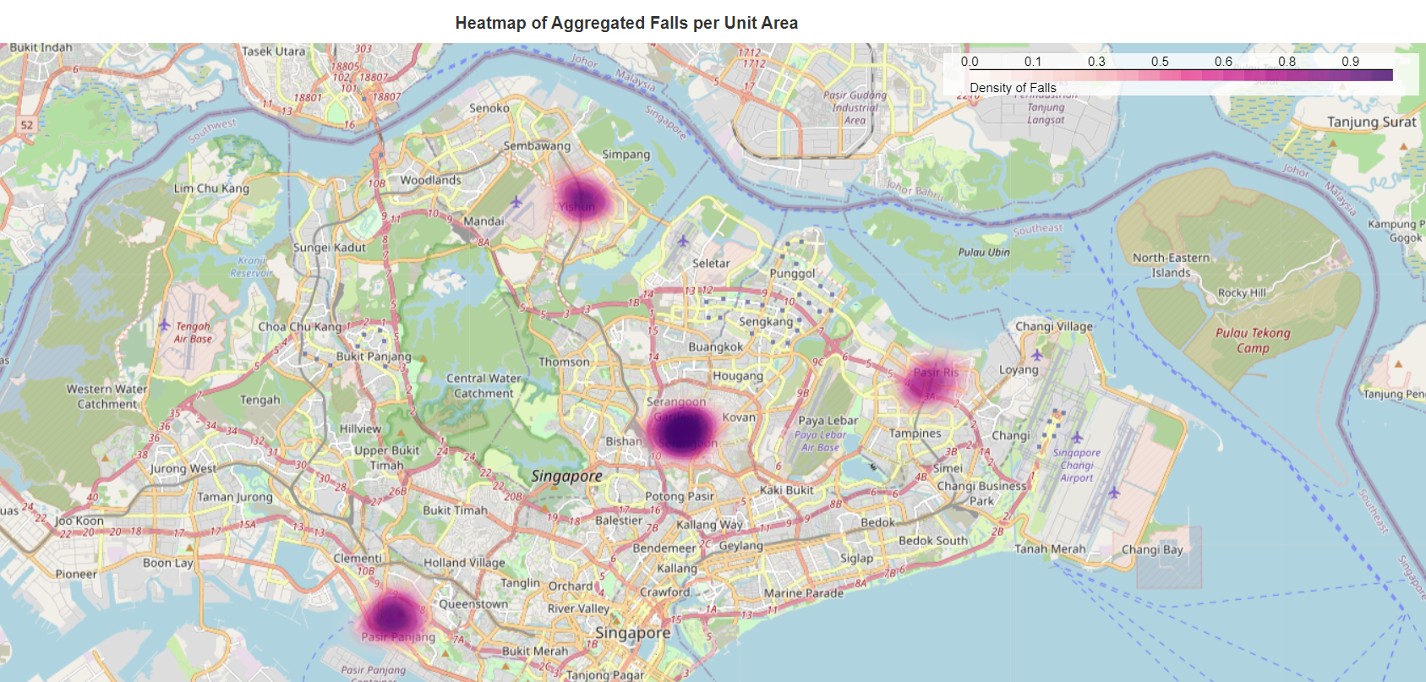
CLOUD
Target user: Urban planners
Where
Why

Slide 21
TECHNICAL ACHIEVEMENTS
01
02
03
Data Processing
Uses SQLite 3 integrated with Flask
User-Friendly Visualization
04
05
06
MQTT Integrated GPS Tracker
Telegram Messaging
GitHub Version Control

Slide 22
CONSIDERATIONS
01
02
POWER CONSIDERATIONS
SECURITY
Sending GPS data only when needed instead of continuously
Sampling Rate of 20Hz following Nyquist Rate (98% of human actions capped under 10Hz) [1]
Credentials are removed when data is sent to cloud
[1] https://www.ncbi.nlm.nih.gov/pmc/articles/PMC3859040/

Slide 23
CHALLENGES
01
02
PAINS OF DATA COLLECTION
POWER DELIVERY AFFECTING IMU
03
TROUBLESHOOTING HARDWARE VS SOFTWARE

Slide 24
FUTURE IMPROVEMENTS
01
02
03
Collect more data for better ML prediction
Continual Learning
Optimize Database Schema
04
05
06
GPS Tracker to run in background of phone
Camera for object detection
Text to speech

Slide 25
CONCLUSION
01
02
INTEGRATING COMPONENTS INCREASES COMPLEXITY
SUBCOMPONENTS ARE CHALLENGING ON THEIR OWN
03
IOT SYSTEMS CAN HAVE HUGE POSITIVE IMPACTS ON THE SOCIETY IF IMPLEMENTED CORRECTLY

Slide 26
THANKS!

